Slide 1
The Design and Evolution of Disney’s Hyperion Renderer
20140159 김하준

Slide 2
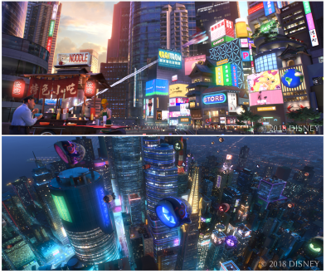
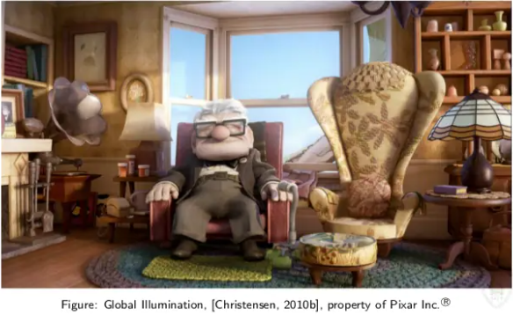
Why a New Renderer?
Reduce artist burden
Coherent texture access

Slide 3
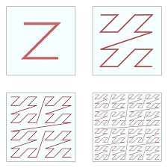
Improve coherence
Process rays in batches to maximize coherence
Primary rays are generated following a space-filling Z-order curve
Before shading, hit points are sorted by scene object and mesh face index

Slide 4
Scene Traversal
Scenes are composed of scene objects, each of which references a traceable and a shader
Traceables are individual meshes or collection of curves, spherical particles, or instances
Each Traceable has BVH optimized for detecting ray hits.

Slide 5
Scene Traversal
Top level hierarchy traces 32-ray packet with a bounding cone against BVH
Bottom level hierarchy traces individual rays against BVH
Load scene objects on demand to enable out-of-core rendering

Slide 6
Surface Shading
Group and sort the resulting hit points for shading coherence
Shaders compute surface scattering, enqueuing new radiance-gathering rays into a future ray batch
Texture filtering is based on ray diameter, which can be interpreted as a cone

Slide 7
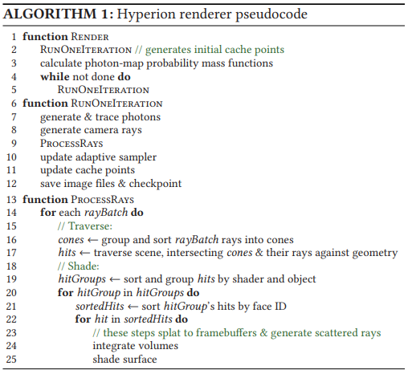
Iteration

Slide 8
Dealing with Monte Carlo Noise

Slide 9
Dealing with Monte Carlo Noise
Adaptive sampling
No localized SPP control
Spatial and temporal filters
Manual in-render, post-render techniques

Slide 10
Design Philosophy
Simplicity over flexibility
General rather than specialized solutions
Artist iteration over final frame efficiency

